Slide 1


Slide 2
UML - Standard Diagrams
Structural Diagrams
Behavioral Diagrams

Slide 3
Structural Diagrams
Class diagram
Object diagram
Component diagram
Deployment diagram

Slide 4
Class diagram
UML CLASS DIAGRAM gives an overview of a software system by displaying classes, attributes, operations, and their relationships.
This Diagram includes the class name, attributes, and operation in separate designated compartments.
Class Diagram defines the types of objects in the system and the different types of relationships that exist among them.

Slide 5
Class diagram
Benefits of Class Diagram
Class Diagram Illustrates data models for even very complex information systems
It provides an overview of how the application is structured before studying the actual code. This can easily reduce the maintenance time
Helpful for developers and other stakeholders.

Slide 6
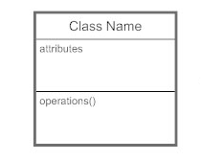
Class diagram
Basic Class Diagram Symbols and Notations
Class Name Written in Italics : Abstract Class
Sona Maria Sebastian-AP, Department of MCA Amal Jyothi College Of Engineering, Kanjirappally

Slide 7
Class diagram
Visibility
Use visibility markers to signify who can access the information contained within a class.
Private visibility, denoted with a - sign, hides information from anything outside the class partition.
Public visibility, denoted with a + sign, allows all other classes to view the marked information.
Protected visibility, denoted with a # sign, allows child classes to access information they inherited from a parent class.

Slide 8
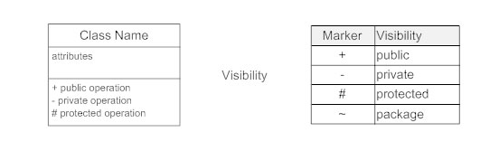
Class diagram

Slide 9
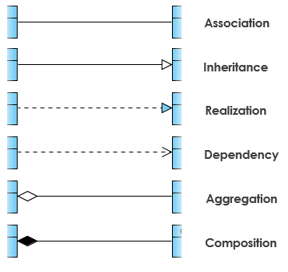
Class diagram
Relationships between classes
UML is not just about pretty pictures.
If used correctly, UML precisely conveys how code should be implemented from diagrams.
If precisely interpreted, the implemented code will correctly reflect the intent of the designer.

Slide 10
Class diagram
Relationships between classes
Association
Associations are relationships between classes in a UML Class Diagram.
They are represented by a solid line between classes.

Slide 11
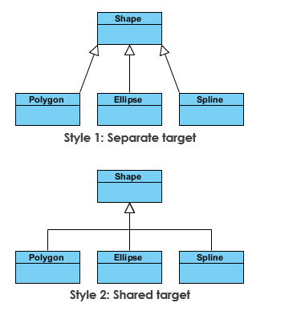
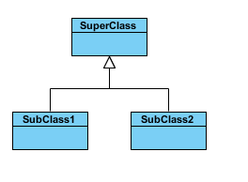
Class diagram
Relationships between classes
2. Inheritance (or Generalization):
Represents an "is-a" relationship.
An abstract class name is shown in italics.
SubClass1 and SubClass2 are specializations of SuperClass.

Slide 12
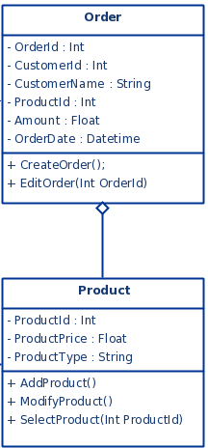
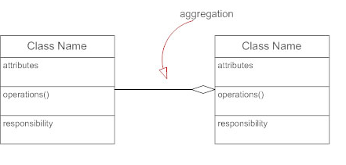
Class diagram
Example 2
Relationships between classes
3. Aggregation
A special type of association.
It represents a "part of" relationship.
In the Example Class2 is part of Class1.
Objects of Class1 and Class2 have separate lifetimes.
Class 1
Class 2
Class 1
Class 2

Slide 13
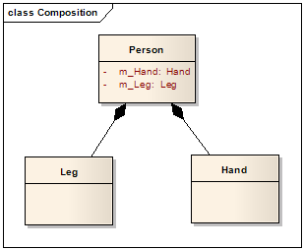
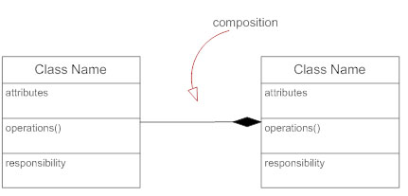
Class diagram
Example 2
Relationships between classes
4. Composition
A special type of aggregation where parts are destroyed when the whole is destroyed.
Objects of Class2 live and die with Class1.
Class2 cannot stand by itself.
Class 1
Class 2
Class 2
Class 1

Slide 14
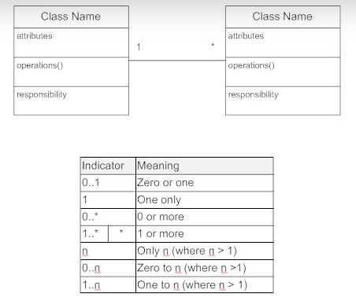
Class diagram
Multiplicity (Cardinality)
Place multiplicity notations near the ends of an association.
These symbols indicate the number of instances of one class linked to one instance of the other class.
For example, one company will have one or more employees, but each employee works for just one company.

Slide 15

Examples
Order System of an application

Slide 16
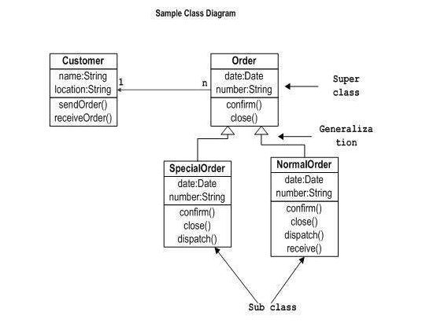
Class diagram - Static view of an application - Example 1

Slide 17
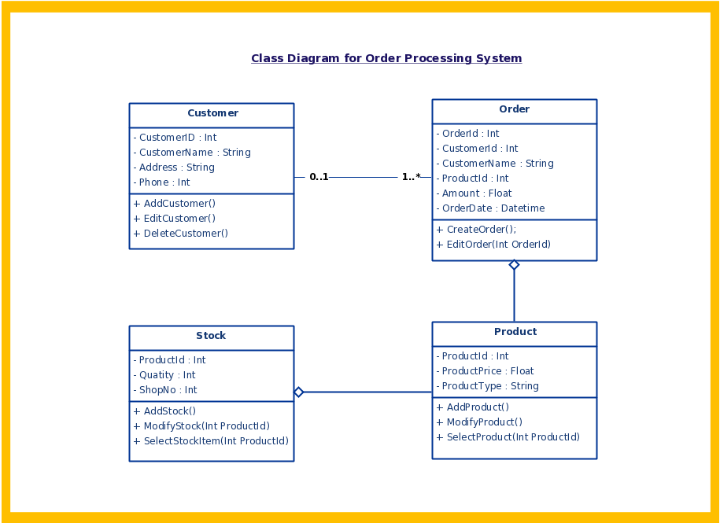
Class diagram - Static view of an application - Example 1

Slide 18
OBJECT DIAGRAM

Slide 19
OBJECT DIAGRAM
Object diagrams are derived from class diagrams so object diagrams are dependent upon class diagrams.
Object diagrams represent an instance of a class diagram.
The basic concepts are similar for class diagrams and object diagrams.
Object diagrams also represent the static view of a system but this static view is a snapshot of the system at a particular moment
Purpose of Object Diagrams
A class diagram represents an abstract model consisting of classes and their relationships.
However, an object diagram represents an instance at a particular moment, which is concrete in nature.
It means the object diagram is closer to the actual system behaviour.
The purpose is to capture the static view of a system at a particular moment.

Slide 20
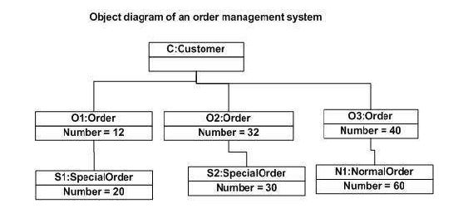
Object Diagrams - instance of a class diagram

Slide 21
OBJECT DIAGRAM
Explanation of Example Diagram
The above diagram is an example of an object diagram.
It represents the Order management system.
The following diagram is an instance of the system at a particular time of purchase.
It has the following objects.
Customer
Order
SpecialOrder
NormalOrder

Slide 22
OBJECT DIAGRAM
Explanation of Example Diagram
Now the customer object (C) is associated with three order objects (O1, O2, and O3).
These order objects are associated with special order and normal order objects (S1, S2, and N1).
The customer has the following three orders with different numbers (12, 32 and 40) for the particular time considered.
The customer can increase the number of orders in future and in that scenario the object diagram will reflect that.
If order, special order, and normal order objects are observed then you will find that they have some values.

Slide 23
COMPONENT DIAGRAM

Slide 24
Component Diagrams
Component diagrams are used to model the physical aspects of a system.
Component diagrams are used during the implementation phase of an application
what are physical aspects?
Physical aspects are the elements such as executables, libraries, files, documents, etc. which reside in a node.
Purpose of Component Diagrams
It does not describe the functionality of the system but it describes the components used to make those functionalities.
It Visualize the components of a system.

Slide 25
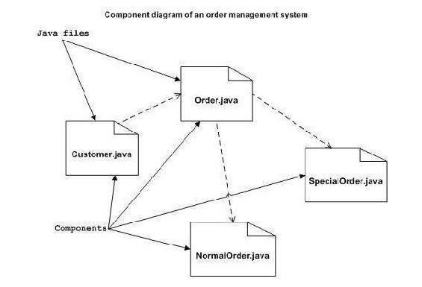
Component Diagrams

Slide 26
DEPLOYMENT DIAGRAM

Slide 27
Deployment diagrams are used to visualize the topology of the physical components of a system, where the software components are deployed.
Deployment diagrams are used for describing the hardware components, where software components are deployed.
Component diagrams and deployment diagrams are closely related
Component diagrams are used to describe the components and deployment diagrams shows how they are deployed in hardware.

Slide 28
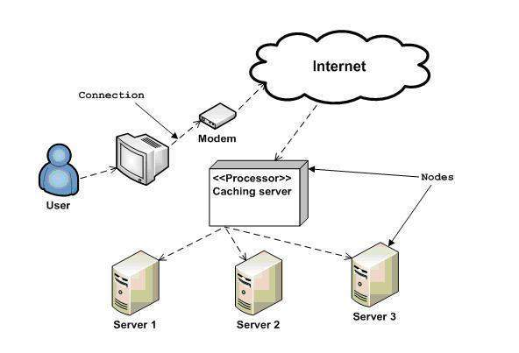
Deployment Diagrams

Slide 29
Behavioral Diagrams - Behaviour of the system when it is running/operating
Use case diagram
Sequence diagram
Collaboration diagram
Statechart diagram
Activity diagram

Slide 30
Use Case Diagrams
use case diagram is dynamic in nature, there should be some internal or external factors for making the interaction.
These internal and external agents are known as actors.
Use case diagrams consists of actors, use cases and their relationships.
A single use case diagram captures a particular functionality of a system.

Slide 31
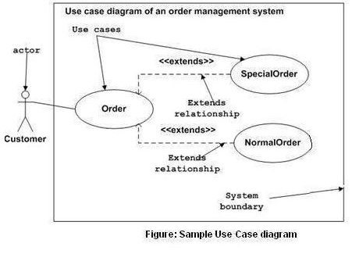
Use Case Diagrams - Used to gather the requirements of a system including internal and external influences

Slide 32
Use Case Diagrams
Sample use case diagram representing the order management system.
Hence, if we look into the diagram then we will find three use cases (Order, SpecialOrder, and NormalOrder) and one actor which is the customer.
The SpecialOrder and NormalOrder use cases are extended from Order use case. Hence, they have extended relationship.
Another important point is to identify the system boundary, which is shown in the picture.
The actor Customer lies outside the system as it is an external user of the system.

Slide 33
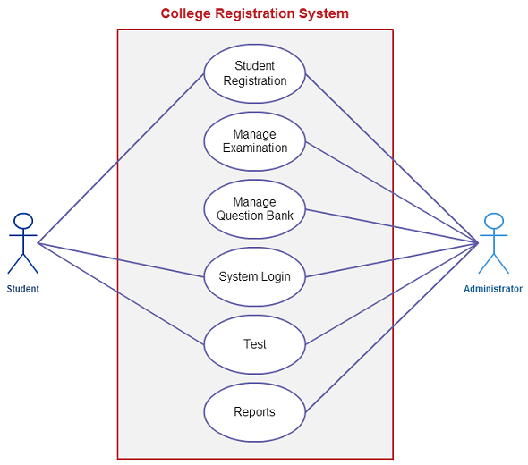
Use Case Diagrams - Example

Slide 34
Interaction Diagrams - Interactions among the different elements in the model
Sequence diagram-emphasizes on time sequence of messages
Collaboration diagram - emphasizes on the structural organization of the objects that send and receive messages

Slide 35
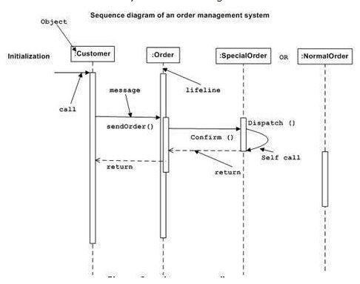
Sequence Diagram- Emphasizes on time sequence of messages

Slide 36
Explanation
The sequence diagram has four objects (Customer, Order, SpecialOrder and NormalOrder).
The diagram shows the message sequence for SpecialOrder object and the same can be used in case of NormalOrder object.
It is important to understand the time sequence of message flows.
The message flow is nothing but a method call of an object.
The first call is sendOrder () which is a method of Order object.
The next call is confirm () which is a method of SpecialOrder object and the last call is Dispatch () which is a method of SpecialOrder object.
The following diagram mainly describes the method calls from one object to another, and this is also the actual scenario when the system is running.

Slide 37
Collaboration diagram
In the collaboration diagram, the method call sequence is indicated by some numbering technique.
The number indicates how the methods are called one after another.

Slide 38
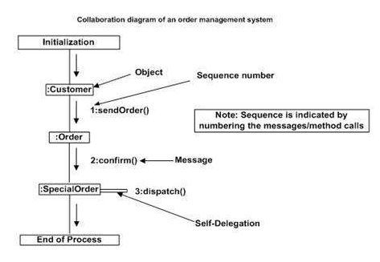
Collaboration diagram - Emphasizes on the structural organization of the objects that send and receive messages.

Slide 39
Statechart Diagrams
A Statechart diagram describes a state machine.
State machine can be defined as a machine which defines different states of an object and these states are controlled by external or internal events.

Slide 40
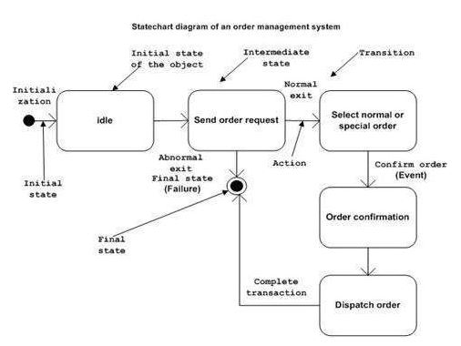
Statechart Diagrams

Slide 41
Activity Diagrams
Activity diagram is basically a flowchart to represent the flow from one activity to another activity.
The control flow is drawn from one operation to another

Slide 42
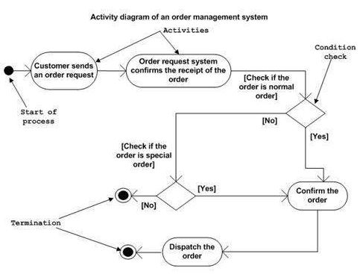
Activity Diagrams – Basically a flowchart to represent the flow from one activity to another activity

